Slide 1
An Automated Hardware/Software Co-Design Flow for Partially Reconfigurable FPGAs
Kostas Andronikos
AEM : 9754

Slide 2
Topics
1
2
3
4
5
DAPR
PR Floorplanning
Evaluation and Results
Introduction
HW/SW PR Partitioning

Slide 3
Introduction
Idea
Partial reconfiguration is a technique that allows for the dynamic modification of a portion of the FPGA
Benefits
Reduced HW, Power, Memory Requirements
Tasks can be executed on SW processors and/or in the HW PRRs
Challenges
Complex Design

Slide 4
Introduction
HW/SW Design Flow
HW/SW PR Partitioning
HW/SW Partitioning, which makes a high-level mapping of tasks into SW and/or HW
PR Partitioning, which locates the HW tasks into one or multiple PRRs
PR Floorplanning
PRR Floorplanning, which sets the physical placements of the PRRs on the FPGA fabric
Partition Pin Floorplanning, which sets the physical placements of the hardware communication interfaces or partition pins
Bitstream and Binary Executable Generation
Notes:
PRR floorplanning sets the physical placements of the PRRs on the FPGA fabric.
Partition pin floorplanning sets the physical placements of the specialized hardwired communication interfaces or partition pins, on PRR boundaries

Slide 5
DAPR
Necessity
Applications have a very large number of functionally-equivalent HW/SW PR partitions with different resource and reconfiguration time tradeoffs
Required lengthy design exploration time for evaluation of all these different partition options
Benefits
Reduction of the required time for evaluating the different partitioning options
Eliminates the need for designers to be familiar with low-level FPGA details and complexities, so reduces manual design effort.

Slide 6
DAPR
Design Flow
Takes as input a modularized application and generate input parameters for HW/SW PR Partitioning
The HW/SW PR generates a set of functionally-equivalent HW/SW PR partitions with associated total resource requirements, reconfiguration times and execution times
The designer analyzes this set and chooses the most suitable partition
The PR Floorplanning improves the clock frequency
Bitstreams and Binary executables are generated

Slide 7
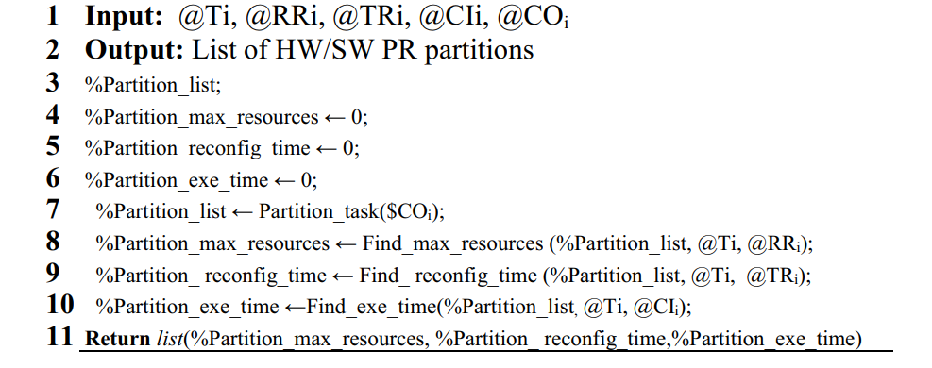
HW/SW PR Partitioning
Performance
For a PR Design with 16 tasks the algorithm detected all the possible partitions in 5 minutes when running on an Intel Core 7 2.5GHz CPU with 8GB RAM
HW/SW PR Partitioning Algorithm

Slide 8
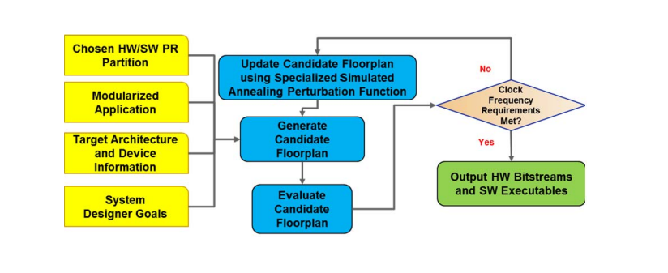
PR Floorplanning
If the clock frequency requirements are not met the candidate floorplan is updated
PR Floorplanning Algorithm

Slide 9
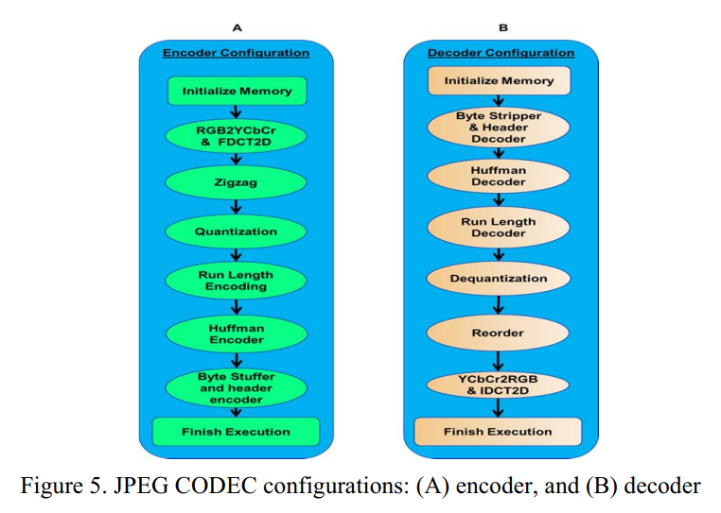
Evaluation and Results
Experimental Set up
JPEG CODEC experiments executed on a PC with an Intel® Core ™ 7 2.5 GHz CPU with 8 GB of RAM.
Notes:
As mentioned earlier, once the base station receives the data , it is subsequently transferred to the TelemetryDrive app through a serial communication channel, since the app operates on a computer.

Slide 10
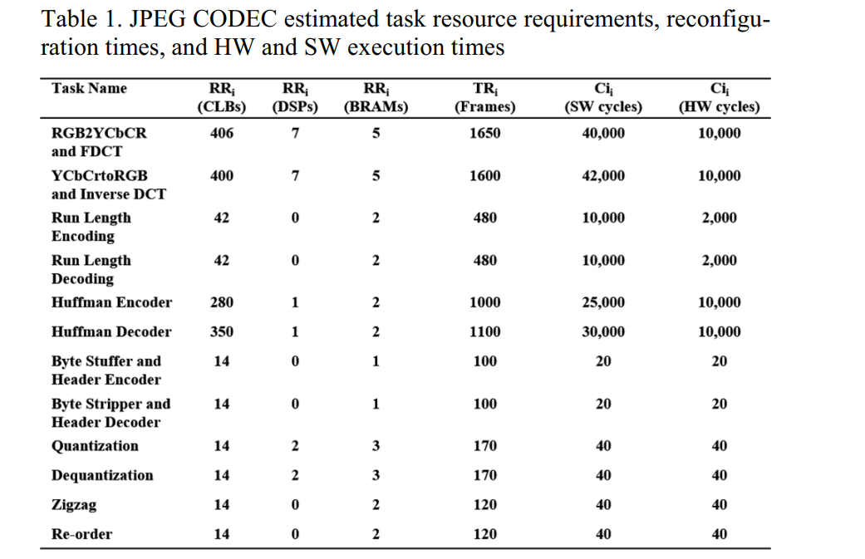
Evaluation and Results
The input parameters for the HW/SW Partitioning
Notes:
The table 1 are the input parameters for the HW/SW PR design partitioning

Slide 11
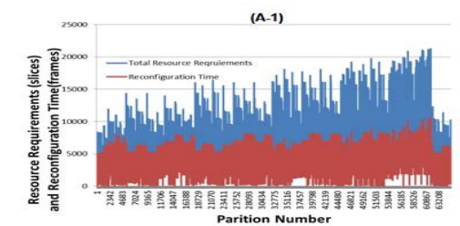
Evaluation and Results

Slide 12
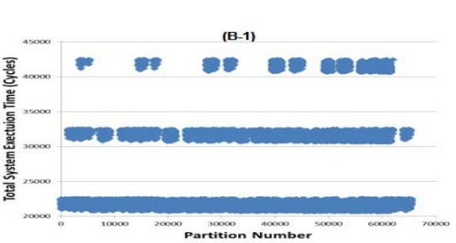
Evaluation and Results

Slide 13
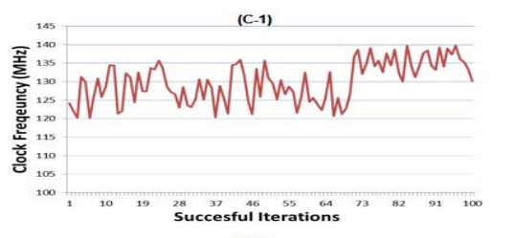
Evaluation and Results

Slide 14
Thank you for your attention

